Slide 1
AV Audio Engine

Slide 2
Overview
Low-latency, real-time audio
Read/write audio files
Play and record audio files and buffers
Connect audio processing blocks (e.g., EQ, delay, etc)
Capture (“tap”) audio anywhere along the chain
Implement 3D audio

Slide 3
Major Blocks
AV Audio Engine
Manages nodes
Sets up connection between nodes
Can be changed on the fly!
Start/stop audio
AV Audio Node
AVAudioOutputNode
AVAudioPlayerNode
AVAudioMixerNode

Slide 4
AV Audio Engine Workflow
Alloc-init the Engine
Alloc-init the Nodes
Attach Nodes to the Engine
Connect Nodes together
Start the Engine
Player
Engine
3.
4.
2.
Output
1.

Slide 5
AV Audio Nodes
Nodes are audio blocks
Sources: player (file or buffer), microphone
Process: mixer, audio effects
Destination: iPhone speaker
The inputs and outputs are specified as busses
Every bus has an AVAudioFormat
Wraps Core Audio Audio Stream Basic Description
Connecting Nodes (e.g., Source to Destination) results in an Active Chain
If any part of the chain is severed, it becomes Inactive

Slide 6
Implicit Nodes
AV Audio Engine comes with 3 implicit nodes
AVAudioOutputNode
Provides audio data to the output hardware
AVAudioInputNode
NOOO-----AUAudioPlayerNode
Schedule playback of files and buffers at a specific time
Multiple buffers with individual callbacks
Buffers can loop

Slide 7
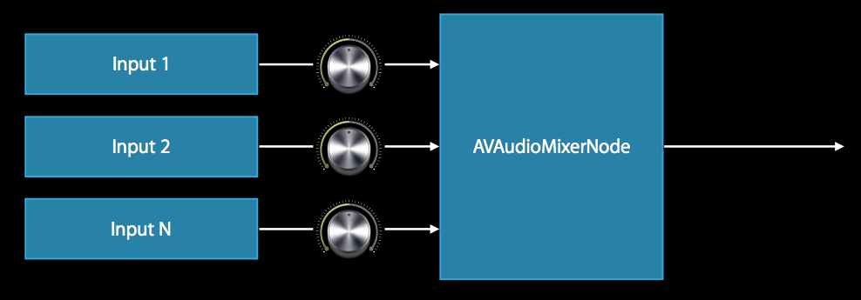
Implicit Nodes (cont’d)
AVAudioMixerNode
Mixer inputs can have different formats!
Combines N inputs into a single output
Individual volume control over each input bus
Volume control over output bus
Sub-mixing (just like sub-groups on a mixing surface)
Can feed output of one Mixer into another Mixer

Slide 8
AV Audio Player Nodes
Pushes audio data into an active chain
Schedule audio data from files and buffers
Schedule immediately, or some time in the future
Sequencer???
Schedule file (or file segment) with a completion callback
Schedule (multiple!) buffers with individual completion callbacks
Schedule buffers with looping

Slide 9
AV Audio Format
Provides a format descriptor for digital audio samples
Access to sample rate, channel count, interleaving, etc.
Core Audio uses a standard for OS X and iOS
Non-interleaved, linear PCM, 32-bit floating point samples
Canonical formats are deprecated (e.g., audio stream basic descriptions)
Other common formats supported
16 or 32 bit int
64 bit floating point

Slide 10
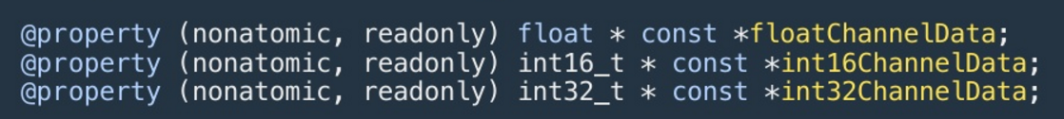
AV Audio PCM Buffer
Memory buffer for storing audio data in PCM format
Format and size determined at creation
Wraps Core Audio audioBufferList
Access data easily as several different types:

Slide 11
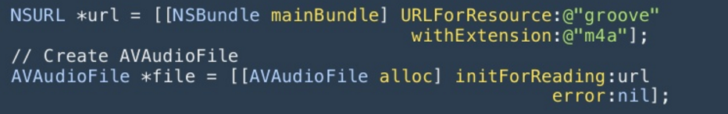
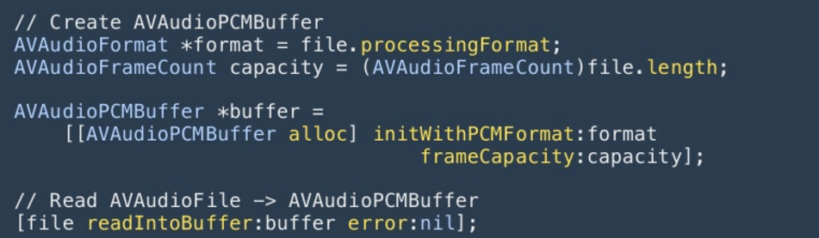
AV Audio Files and Buffers
Creating an AVAudioFile
Copying the file into an AVAudioBuffer

Slide 12
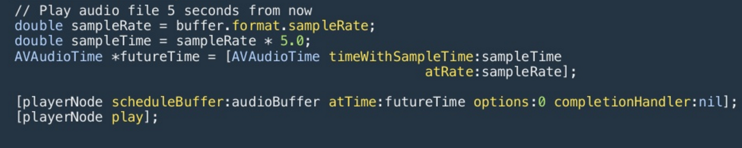
Scheduling Playback
Immediate File Playback
Immediate Buffer Playback
Future Buffer Playback

Slide 13
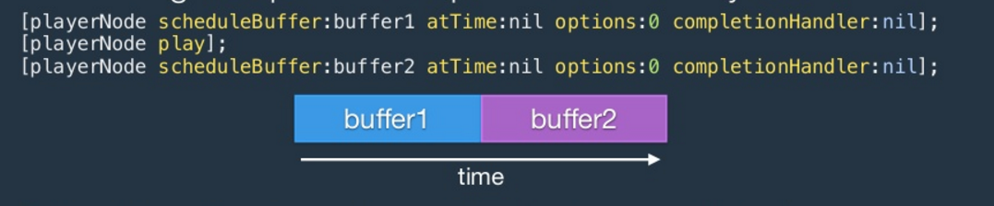
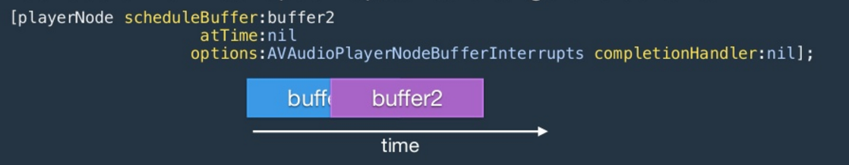
Scheduling Playback (cont’d)
Serialized playback
Interrupted playback

Slide 14
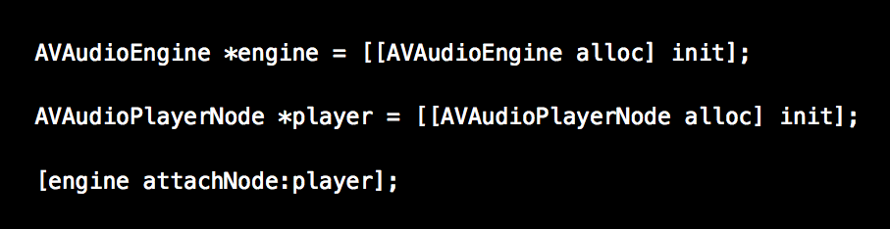
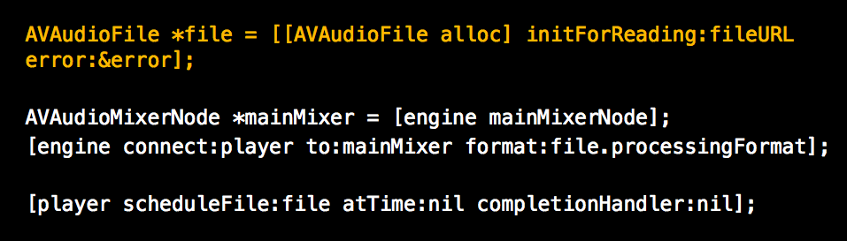
Code Example (Getting started)
Create Engine and Node
Setup Player with File

Slide 15
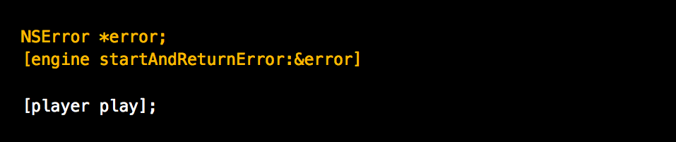
Code Example (Getting started)
Start Engine and Play

Slide 16
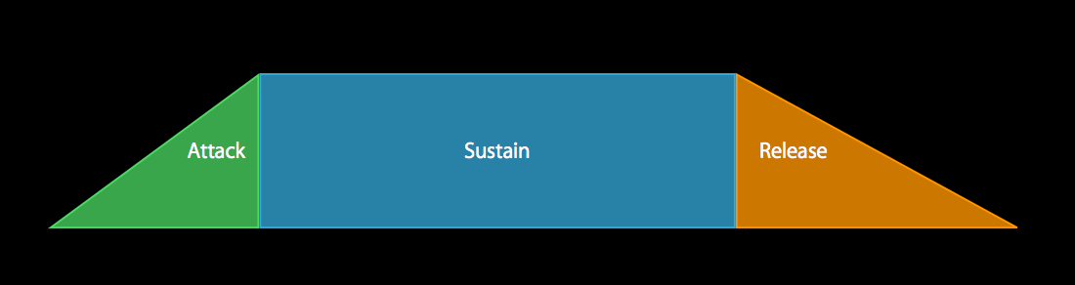
Code Example (Amplitude Envelope)
Concept
Onset buffer (note-on)
Steady-state buffer
(looping while note-down; schedule to play after onset buffer)
Offset buffer (note off; interrupt steady-state buffer)

Slide 17
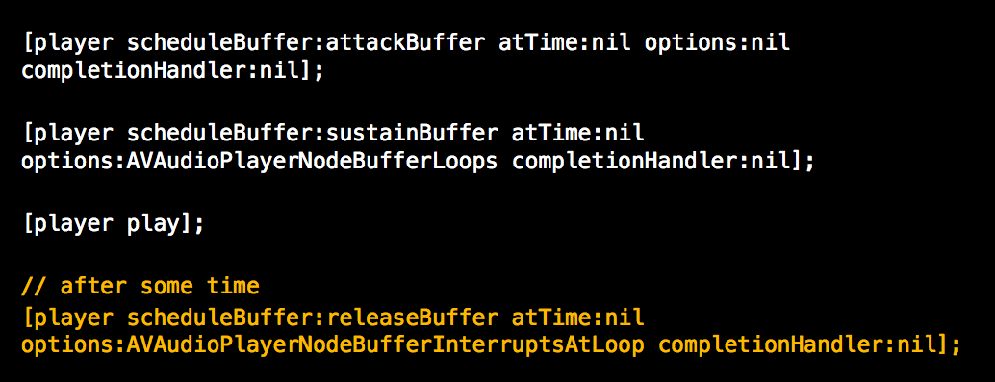
Code Example (Amplitude Envelope)
Schedule attackBuffer for now
After that, append sustainBuffer with Loop options
Play
Allow releaseBuffer to Interrupt the sustainBuffer

Slide 18
Node Taps
Captures the output of a Node
Can be used to:
Record microphone data
Provide real-time audio analysis (e.g., FFT)
Capture the output mix
Etc.
Can have up to one tap per Node
Captured data is returned in a callback block

Slide 19
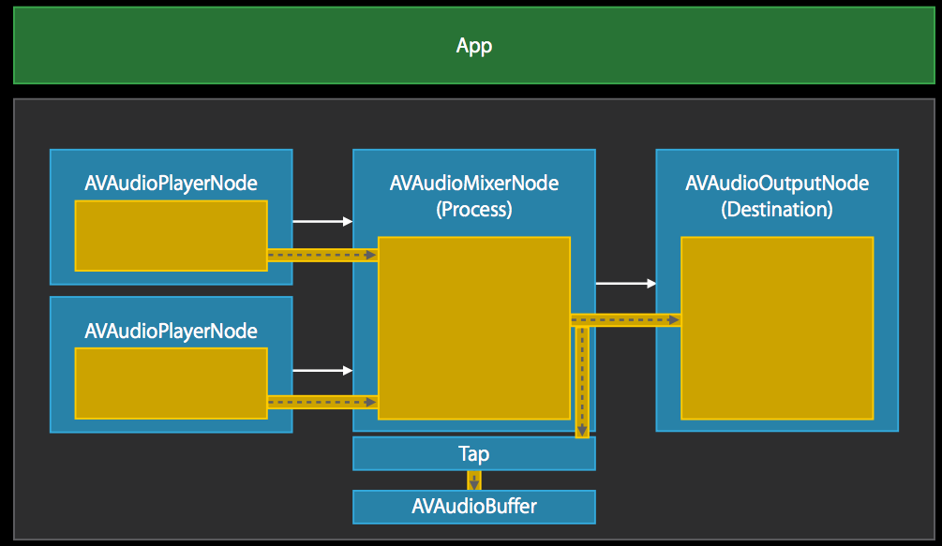
Node Taps

Slide 20
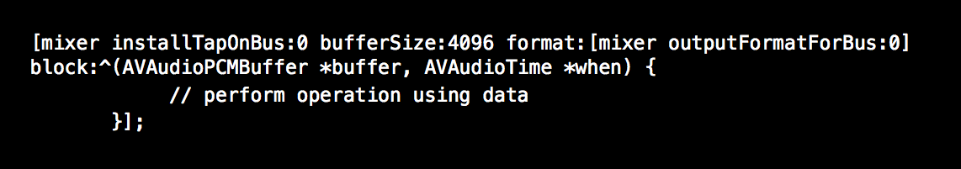
Node Taps
Completion Blocks serve many purposes and come in many forms. Here, it is as an argument to a method call
By the time installTapOnBus finishes executing on mixer, the buffer will already have been analyzed
Can be thought of as a callback
Useful, quick, and slightly more readable alternative to @protocols
Can still run on a separate thread for processes of unknown duration

Slide 21
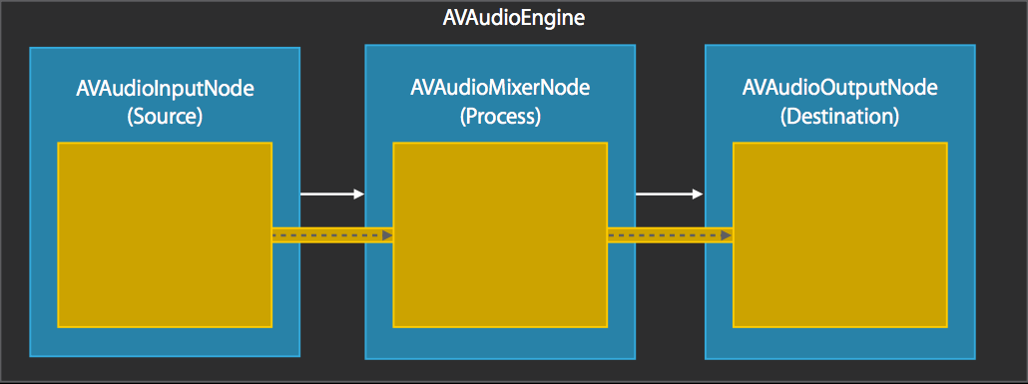
AV Input Nodes
One of the implicit nodes of the AV Audio Engine
Receives audio data from the input hardware
Data is pulled when a connection chain is active

Slide 22
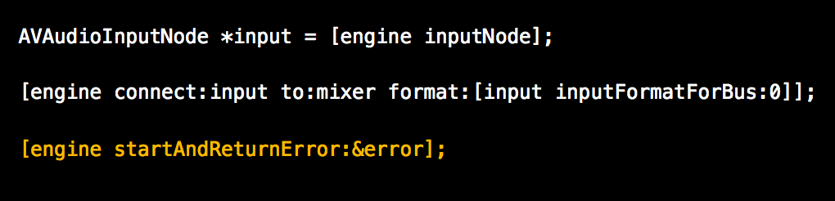
AV Input Nodes
Code Example

Slide 23
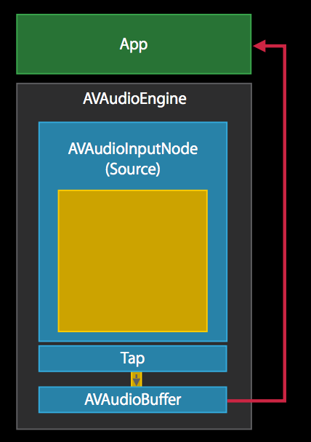
AV Input Nodes
Use a tap to capture the mic in real-time

Slide 24
AV Audio Effect Nodes
Two main classes:
AVAudioUnitEffect
Real-time
N frames in, N frames out
Can be connected to input nodes
AVAudioUnitTimeEffect
Non-real-time
N frames in, M frames out
(e.g., time-stretching is 24 ms in and >24 ms out)
Cannot be connected to input nodes

Slide 25
AV Audio Effect Nodes
Currently available effects:
AVAudioUnitEffect
EQ
Distortion
Reverb
Delay
AVAudioUnitTimeEffect
Varispeed
Time-pitch shifting

Slide 26
AV Audio Unit Delay
Parameters
delayTime
feedback
lowPassCutoff
wetDryMix

Slide 27
AV Audio Unit Distortion
Presets
loadFactoryPreset (LOTS!)
Parameters
preGain (-80 to +20 dB)
wetDryMix (0 to 100%)
…doesn’t sound terrible, but, doesn’t sound great either...

Slide 28
AV Audio Unit Reverb
Presets
loadFactoryPreset (small room, large room, cathedral, etc)
Parameters
wetDryMix (0 to 100%)

Slide 29
AV Audio Unit EQ
Parameters
Bands: array of EQ Filter Parameters
filterType: HPF, LPF, BPF, parametric, shelving
Frequency (cutoff)
Bandwidth (in octaves)
Gain (dB???)
bypass
globalGain

Slide 30
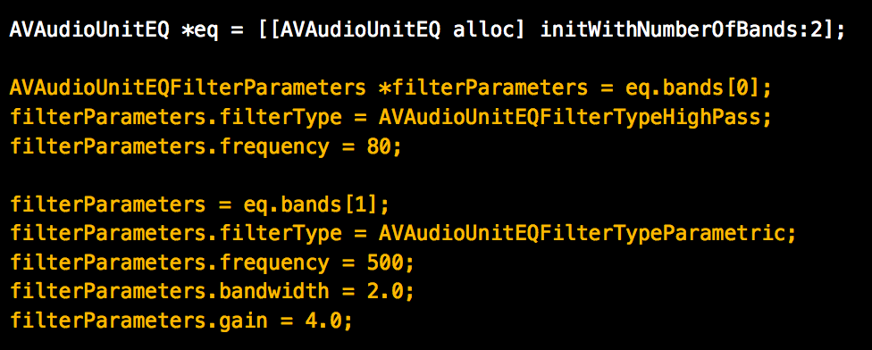
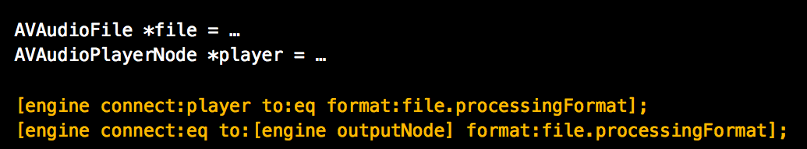
AV Audio Effect Nodes
Code Example: 2-band EQ
Band 1: HPF @ 80 Hz
Band 2: 4 dB boost @ 500 Hz

Slide 31
AV Audio Unit Time Effect
Non-real-time effects
May have different sized input and output buffers
Time-Pitch Effect
Affect playback rate (x1/32 to x32.0)
and pitch shifting (-2400 to 2400 cents) independently
Varispeed
Affect just the playback rate via resampling (so pitch and rate are coupled) from 0.5x to 4.0x

Slide 32
3D Audio
AV Audio Environment Node
A mixer that simulates 3D space
Source nodes (must be mono) can be spatialized
Set source parameters with AVAudioMixing protocol
Position
Rendering algorithm
Obstruction/occlusion
Environmental parameters
Listener position/orientation
Distance attenuation
reverberation

Slide 33
3D Audio
AV Audio Environment Node
Directional cues
ITD
IID
Head shadows
Rendering algorithms
Equal-power panning
HRTF

Slide 34
AV Audio Unit Sampler
Reads in MIDI
Note on/off, controller, pitch bend, etc.
High-quality sampler that can load in EXS, SF2, or DLS formats, or an arbitrary array of audio samples

